Slide 1
Machine Learning DSECL ZG565
Dr. Chetana Gavankar, Ph.D,
IIT Bombay-Monash University Australia
Chetana.gavankar@pilani.bits-pilani.ac.in

Slide 2
Lecture No. – 2 | Math Preliminaries
Date – 06/09/2020
Time – 2:00 PM – 4:00 PM
These slides are prepared by the instructor, with grateful acknowledgement of Prof. Sugato Ghosal from BITS Pilani and many others who made their course materials freely available online.

Slide 3
Session Content
Linear Algebra Review
Calculus Review
Probability Theory
Decision Theory

Slide 4
Linear algebra Review
See http://cs229.stanford.edu/section/cs229-linalg.pdf for more

Slide 5
Vectors and Matrices
Collections of ordered numbers that represent movements in space, word counts, movie ratings, pixel brightness, etc.
Vector is a mathematical quantity that has magnitude and direction

Slide 6
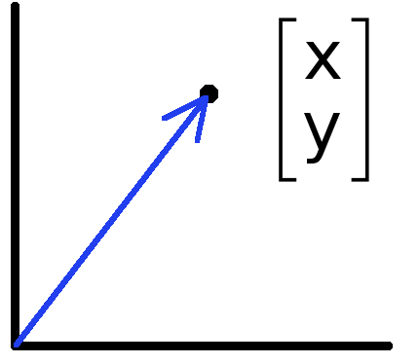
Vectors
Data can also be treated as a vector
Such vectors don’t have a geometric interpretation, but calculations like “distance” still have value
Vectors can represent an offset in 2D or 3D space
Points are just vectors from the origin

Slide 7
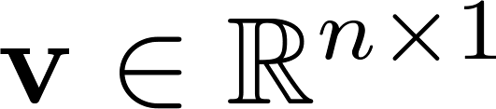
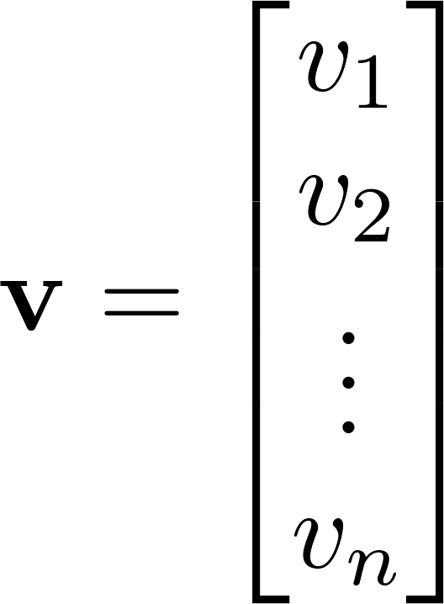
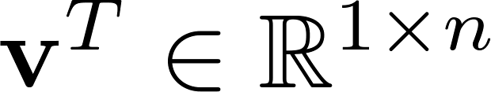
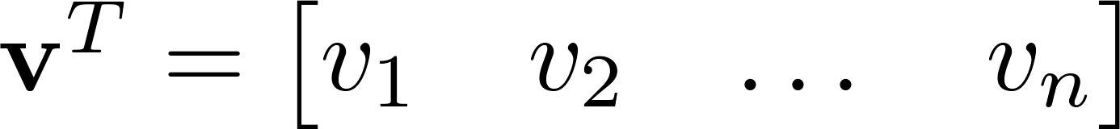

Vector
A column vector where
A row vector where
denotes the transpose operation

Slide 8
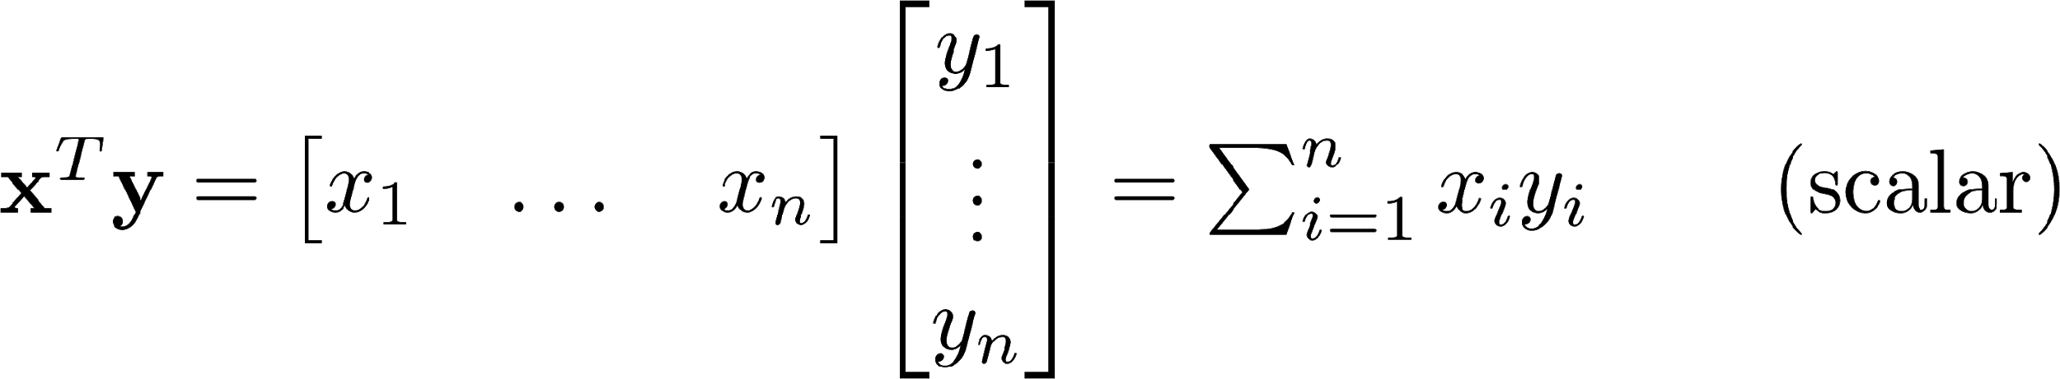
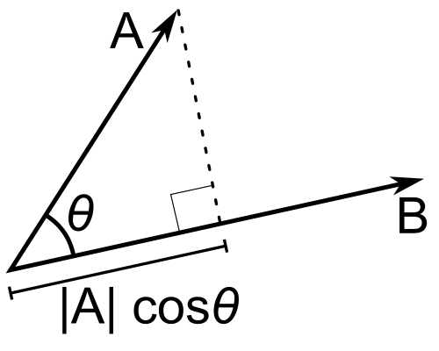
Inner Product
Multiply corresponding entries of two vectors and add up the result
If B is a unit vector, then A·B gives the length of A which lies in the direction of B (projection)
(if B is unit-length hence norm is 1)

Slide 9
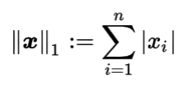
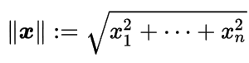
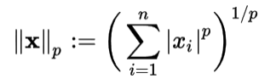
Norms
Norm is a function that assigns a strictly positive length or size to each vector in a vector space—except for the zero vector
L¹ norm - One-dimensional vector spaces
L² norm - n-dimensional Euclidean space R^{n},
L^{p} norm - Let p ≥ 1 be a real number. The p norm of vector x=(x₁, x₂,…x_{n})

Slide 10
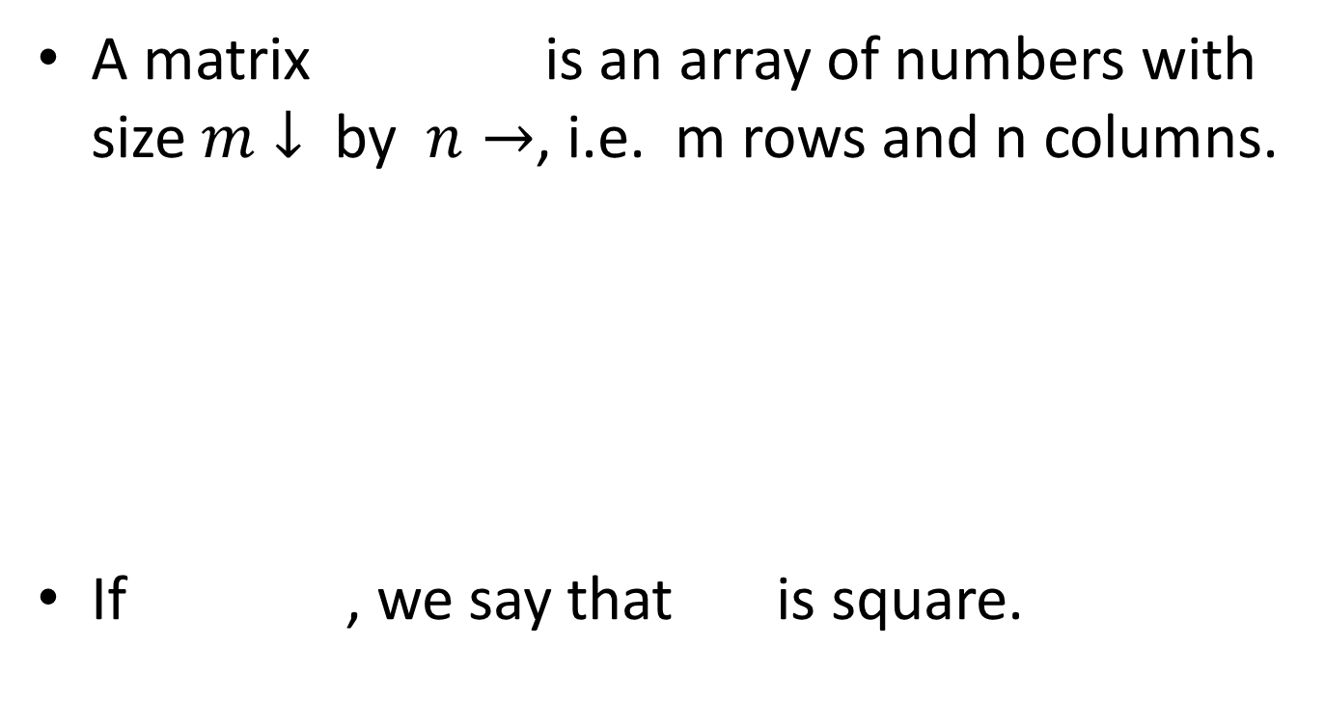
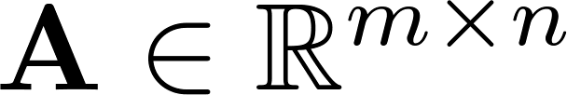
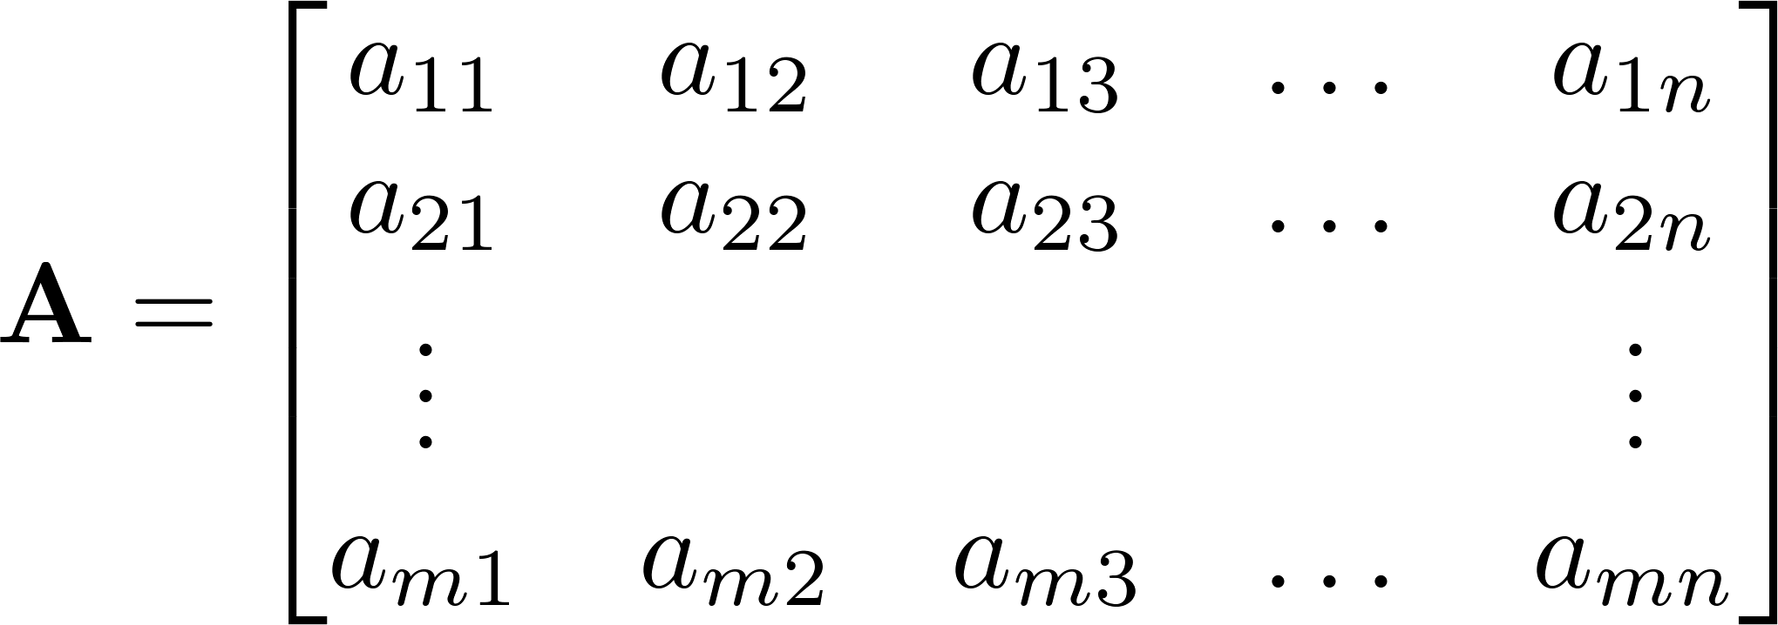


Matrix

Slide 11
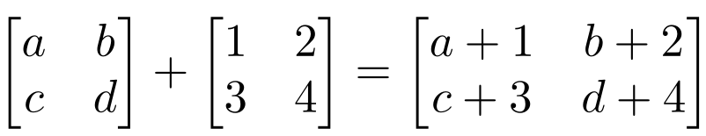
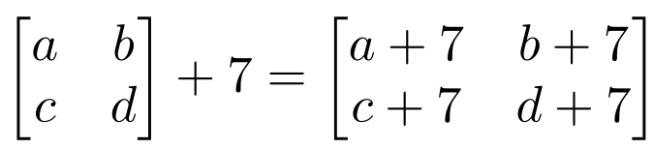
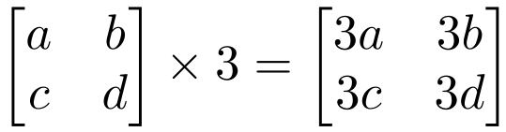
Matrix Operations
Addition
Can only add a matrix with matching dimensions, or a scalar.
Scaling

Slide 12
Matrix Multiplication
Let X be an axb matrix, Y be an bxc matrix
Then Z = X*Y is an axc matrix
Second dimension of first matrix, and first dimension of first matrix have to be the same, for matrix multiplication to be possible

Slide 13
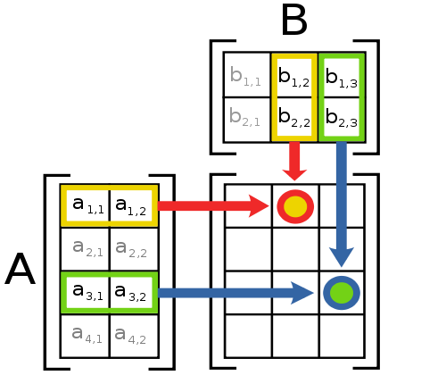
Matrix Multiplication
The product AB is:
Each entry in the result is (that row of A) dot product with (that column of B)

Slide 14
Different types of product
x, y = column vectors (nx1)
X, Y = matrices (mxn)
x, y = scalars (1x1)
x^{T} y = x · y = inner product (1xn x nx1 = scalar)
x ⊗ y = x y^{T} = outer product (nx1 x 1xn = matrix)
X * Y = matrix product
X .* Y = element-wise product

Slide 15
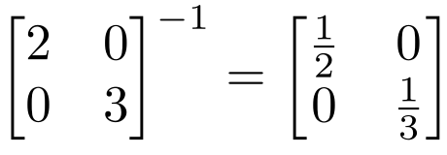
Inverse
Given a matrix A, its inverse A⁻¹ is a matrix such that AA⁻¹ = A⁻¹A = I
E.g.
Inverse does not always exist. If A⁻¹ exists, A is invertible or non-singular. Otherwise, it’s singular.

Slide 16
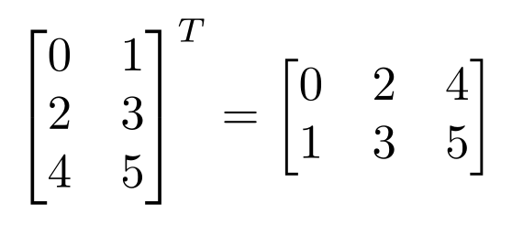
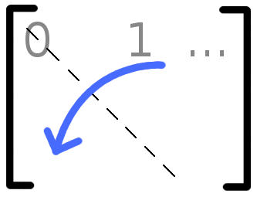

Matrix Operations
Transpose – flip matrix, so row 1 becomes column 1
A useful identity:

Slide 17
Matrix Operation Properties
Matrix addition is commutative and associative
A + B = B + A
A + (B + C) = (A + B) + C
Matrix multiplication is associative and distributive but not commutative
A(B*C) = (A*B)C
A(B + C) = A*B + A*C
A*B != B*A

Slide 18
Linear independence
Suppose we have a set of vectors v₁, …, v_{n}
If we can express v₁ as a linear combination of the other vectors v₂…v_{n}, then v₁ is linearly dependent on the other vectors.
The direction v₁ can be expressed as a combination of the directions v₂…v_{n}. (E.g. v₁ = .7 v₂ -.7 v₄)
If no vector is linearly dependent on the rest of the set, the set is linearly independent.
Common case: a set of vectors v₁, …, v_{n} is always linearly independent if each vector is perpendicular to every other vector (and non-zero)

Slide 19
Matrix Rank
Column/row rank
col-rank(A)=no. of linearly independent columns
row-rank(A)=no. of linearly independent rows
Rank of a matrix is the number of linearly independent rows or columns (whichever is smaller).
Column rank always equals row rank
If a matrix is not full rank, inverse doesn’t exist
Inverse also doesn’t exist for non-square matrices

Slide 20
Matrix Rank
Rank of a matrix denotes the information content of the matrix.
The lower the rank, the lower is the "information content".
For instance, when we say a rank 1 matrix, the matrix can be written as a product of a column vector times a row vector
i.e. if u and v are column vectors, matrix uv^{T} is a rank one matrix.
In general, if we know that a matrix A ∈ R of size m×n is of rank p, then we can write A as UV^{T} where U ∈ R of size m×p and is of rank p and V ∈ R of size n×p and is of rank p

Slide 21

Matrix Rank : Example
Matrix has rank 2: the first two columns are linearly independent, so the rank is at least 2,
the third column is a linear combination of the first two (the second subtracted from the first), the three columns are linearly dependent so the rank must be less than 3

Slide 22
Orthogonal Matrix
Orthogonal matrix is a square matrix whose columns and rows are orthogonal unit vectors (i.e., orthonormal vectors), i.e. QᵀQ=QQᵀ=I, where I is the identity matrix.
Matrix Q is orthogonal if its transpose is equal to its inverse: Qᵀ=Q⁻¹.

Slide 23
Eigenvalues and Eigenvectors
The vector x is an eigenvector of matrix A and λ is an eigenvalue of A if: Ax= λx
Eigenvalues and eigenvectors are only defined for square matrices (i.e., m = n)
Eigenvectors are not unique (e.g., if λ is an eigenvector, so is k λ)
Zero vector is a trivial solution to the eigenvalue equation for any number λ and is not considered as an eigenvector.
Interpretation: the linear transformation implied by A cannot change the direction of the eigenvectors λ, but change only their magnitude.
(assume non-zero x)

Slide 24





Eigenvalues and Eigenvectors
Example: Find Eigen pairs of
Step I. Find the eigenvalues.

Slide 25

Computing λ and v
To find the eigenvalues λ of a matrix A, find the roots of the characteristic polynomial :
Ax= λx
Example:

Slide 26
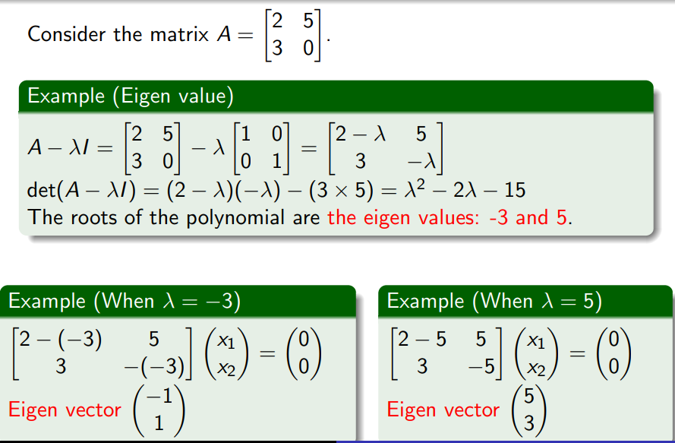
Computing λ and v

Slide 27




Example:
Find the eigenvalues and corresponding eigenvectors of
The characteristic polynomial is
Its factors are
So the eigenvalues are 1, 2, and 3.
Corresponding eigenvectors are

Slide 28
Positive Definite Matrices
THEOREM
A symmetric matrix A is positive definite
if and only if all the eigenvalues of A are positive.
EXAMPLE Showing That a Matrix Is Positive Definite
Solution
The characteristic equation of A is

Slide 29
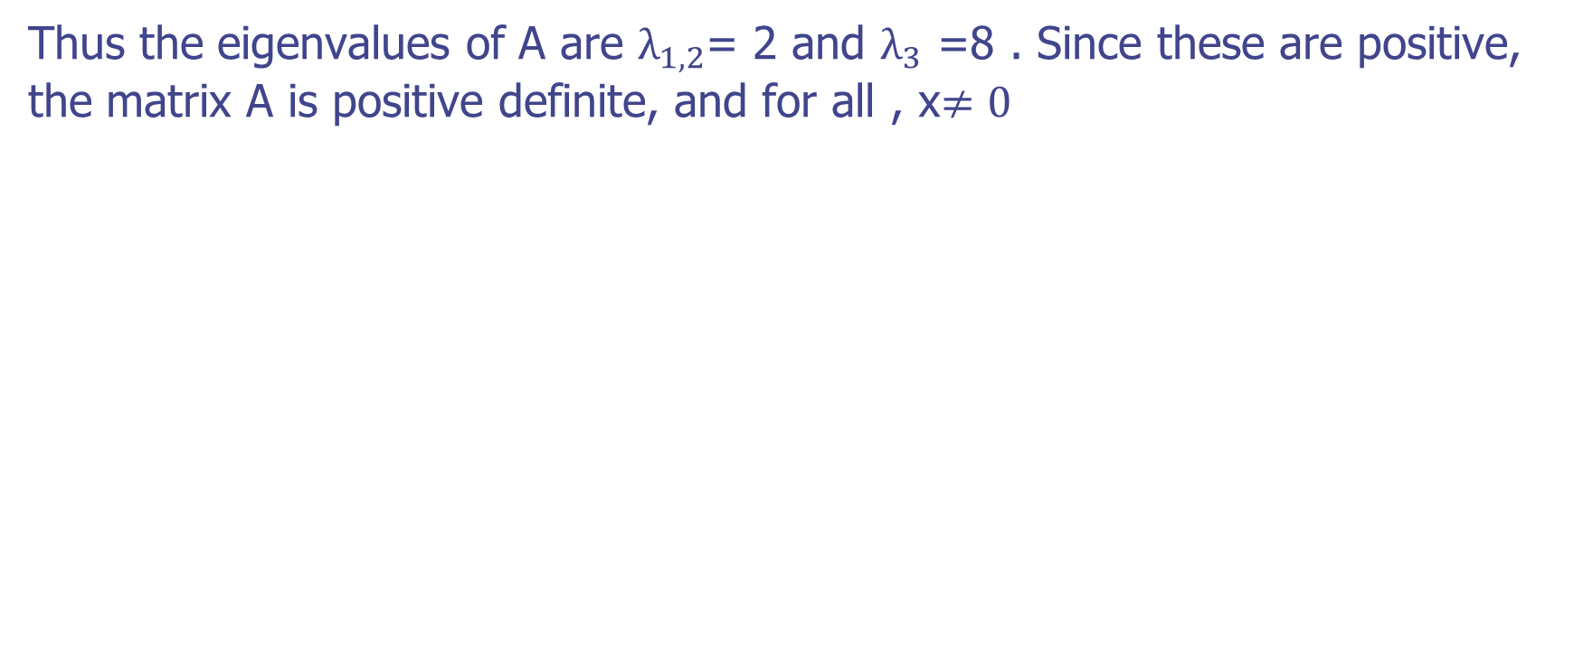
Positive Definite Matrices
Thus the eigenvalues of A are $λ_{1,2}$= 2 and $λ_{3}$ =8 . Since these are positive, the matrix A is positive definite, and for all , x$≠0$
Our next objective is to give a criterion that can be used to determine whether a symmetric matrix is positive definite without finding its eigenvalues.
To do this, it will be helpful to introduce some terminology.
If is a square matrix,

Slide 30
Positive Definite Matrices
THEOREM
A symmetric matrix A is positive definite
if and only if all the eigenvalues of A are positive.
EXAMPLE Showing That a Matrix Is Positive Definite
Solution
The characteristic equation of A is
Thus the eigenvalues of A are $λ_{1,2}$= 2 and $λ_{3}$ =8 . Since these are positive, the matrix A is positive definite, and for all , x$≠0$

Slide 31

Maxima and Minima of a function

Slide 32
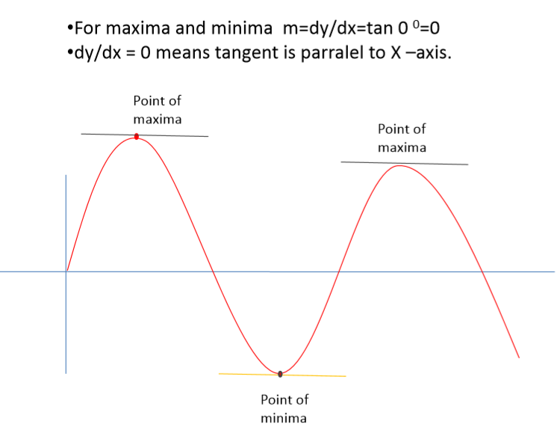
Maxima and Minima

Slide 33
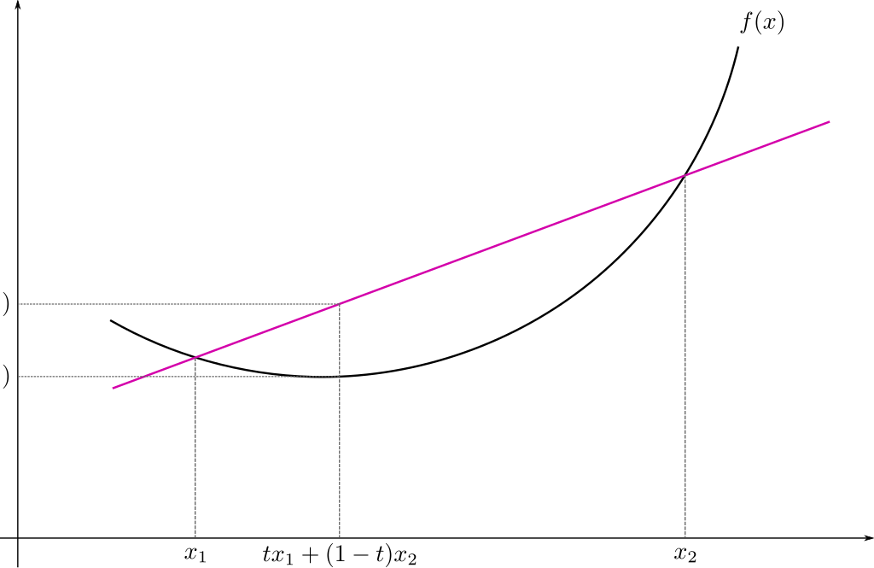
Convex Function

Slide 34
Convex Function
Real-valued function defined on an
n-dimensional interval is called convex if the line segment between any two points on the graph of the function lies above or on the graph

Slide 35
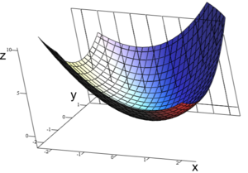
Convex Function : Multivariate

Slide 36
Calculus review

Slide 37
Differentiation
The derivative provides us information about the rate of change of a function.
The derivative of a function is also a function. Example:
The derivative of the acceleration function is the velocity function.
Texas A&M Dept of Statistics

Slide 38
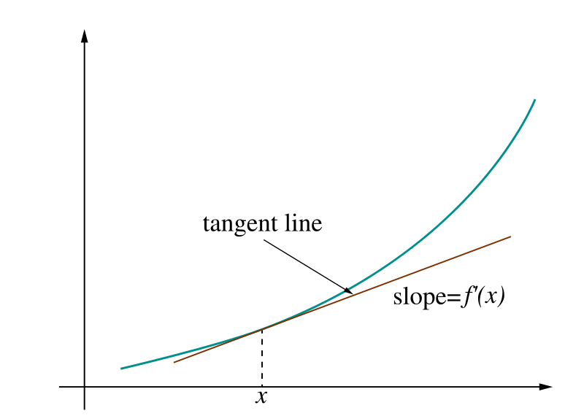
Derivative = rate of change
Image: Wikipedia

Slide 39
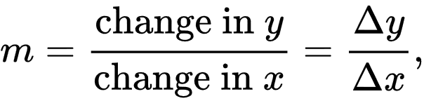
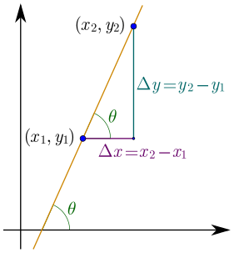
Derivative = rate of change
Linear function y = mx + b
Slope
Image: Wikipedia

Slide 40
Ways to Write the Derivative
Given the function f(x), we can write its derivative in the following ways:
- f '(x)
- ^{d} f(x)
dx
The derivative of x is commonly written dx.
Texas A&M Dept of Statistics

Slide 41
Differentiation Formulas
The following are common differentiation formulas:
- The derivative of a constant is 0.
^{d} c = 0
du
- The derivative of a sum is the sum of the derivatives.
^{d} ( f (u) + g(u)) = f '(u) + g'(u)
du
Texas A&M Dept of Statistics

Slide 42
More Formulas
- The derivative of u to a constant power:
^{d} u^{n} = n *u^{n−1}
du
- The derivative of e:
^{d} e^{u} = e^{u}
du
- The derivative of log:
^{d} log(u) = ¹ du u
Texas A&M Dept of Statistics

Slide 43
Product and Quotient
The product rule and quotient rules are commonly used in differentiation.
- Product rule:
^{d} ( f (u)* g(u)) = f (u)g'(u) + g(u) f '(u)
du
- Quotient rule:
( )
g(u) f '(u) − f (u)g'(u)
d f (u)
=
du g(u)
2
g (u)
Texas A&M Dept of Statistics

Slide 44
Chain Rule
The chain rule allows you to combine any of the differentiation rules we have already covered.
- First, do the derivative of the outside and then do the derivative of the inside.
d
f (g(u)) = f '(g(u))* g'(u)* du
du
Texas A&M Dept of Statistics

Slide 45
Try These
f (z) = z +11
s( y) = 4 ye^{2 y}
log(x² )
g( y) = 4 y³ + 2 y
p(x) =
x
h(x) = e^{3x}
Texas A&M Dept of Statistics

Slide 46
Solutions
f '(z) = 1
s'( y) = 8ye^{2 y}
4e^{2 y}
2 − log(x² )
p'(x) =
_{x}2
g'( y) = 12 y² + 2
h'(x) = 3e^{3x}
Texas A&M Dept of Statistics

Slide 47
Probability Review

Slide 48
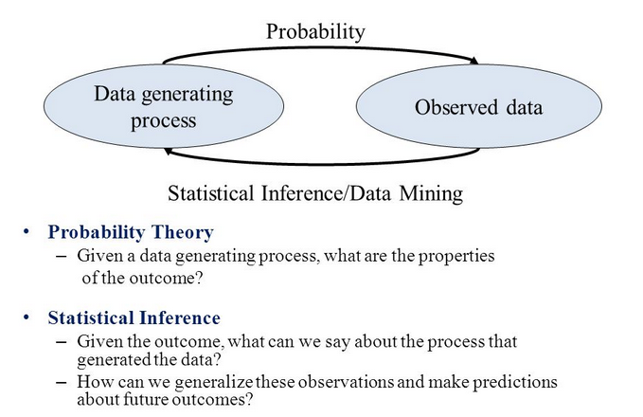
Probability Theory

Slide 49
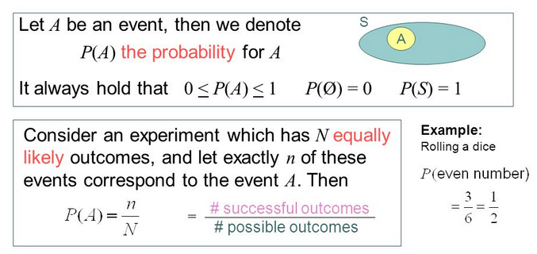
Probability Theory

Slide 50
Random Variable
A random variable, usually written X, is a variable whose possible values are numerical outcomes of a random phenomenon or experiment.
Examples
X = number of heads when the experiment is flipping a coin 20 times.
C = the daily change in a stock price.
R = the number of kilometers per litre you get on your car during a family vacation.

Slide 51
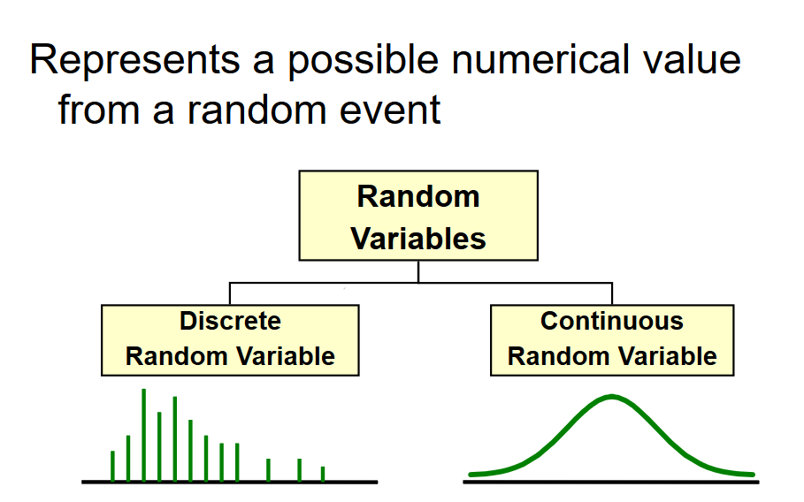
Random Variable

Slide 52
Random Variable
Discrete Random Variable
one that takes on a countable number of values
usually count data [Number of]
list all possible outcomes without missing any of them
Example:
X = sum of values on the roll of two dice:
X has to be either 2, 3, 4, …, or 12.
Y = number of students in MTech DSE:
Y has to be 60,65,70 …………

Slide 53
Random Variable
Continuous Random Variable
Variable that takes on an uncountable number of values
Usually measurement data [time, weight, distance, etc]
You can never list all possible outcomes even if you had an infinite amount of time
Example:
X = time it takes you to drive home from work place: X > 0, might be 30.1 minutes measured to the nearest tenth but in reality the actual time is 30.10000001…………………. minutes?)
Exercise: try to list all possible numbers between 0 and 1

Slide 54
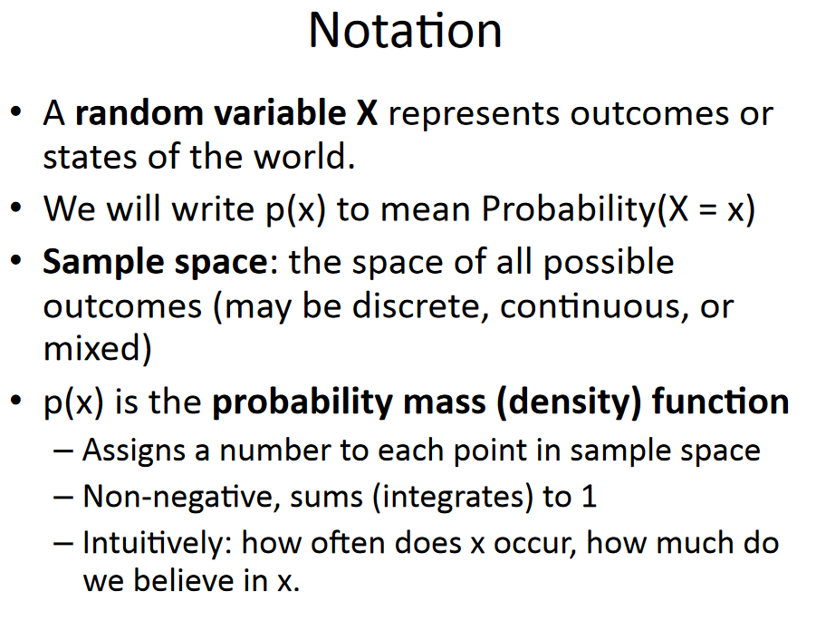
Probability Theory

Slide 55
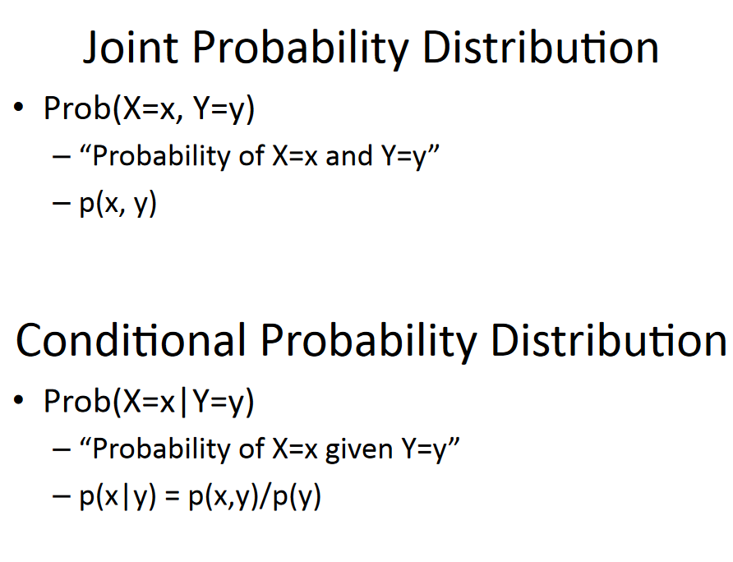
Probability Theory

Slide 56
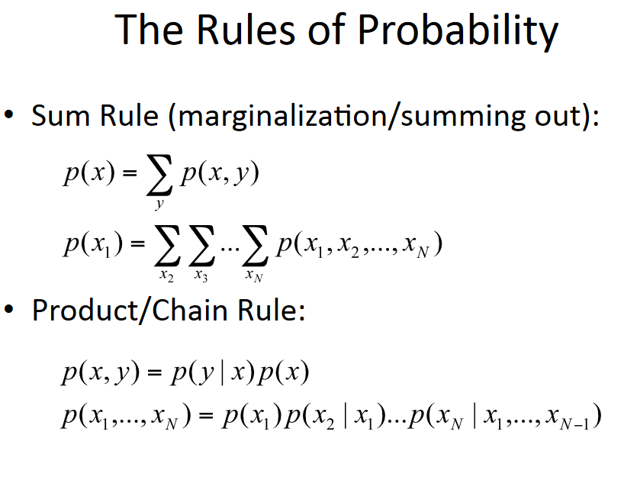
Probability Theory

Slide 57
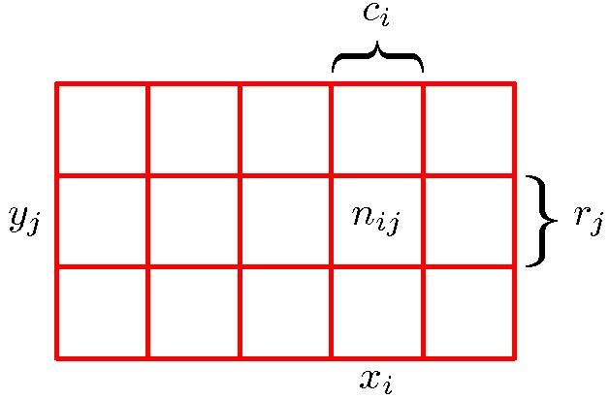
Probability Theory
X and Y are two discrete random variables.
X can take any of the values x_{i}, i = 1, . . . , M, and Y can take the values y_{j}, j = 1, . . . , L.
Let a total of N trials in which we sample both of the variables X and Y, and let the number of such trials in which X = x_{i} and Y = y_{j} be n_{ij} .
Let the number of trials in which X takes the value x_{i} be denoted by c_{i}, and similarly let the number of trials in which Y takes the value y_{j} be denoted by r_{j} .

Slide 58
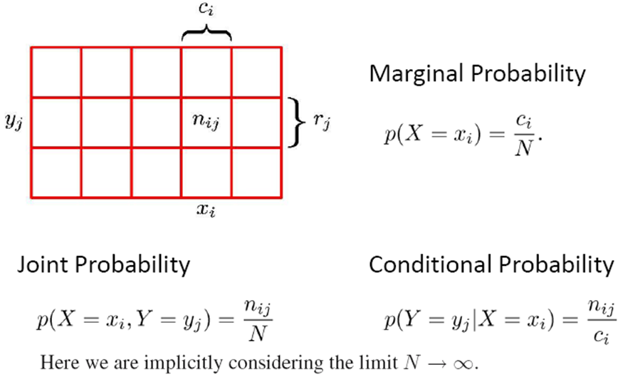
Probability Theory

Slide 59
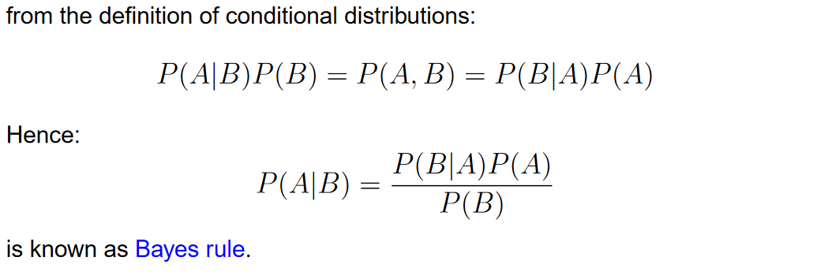
Bayes Rule

Slide 60
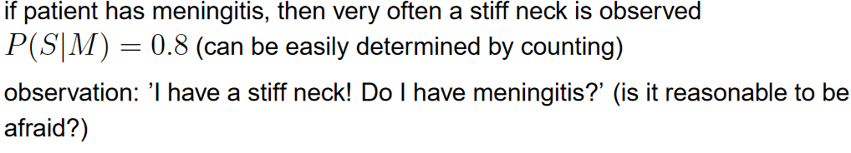
Bayes Rule Example
if patient has meningitis, then very often a stiff neck is observed

Slide 61
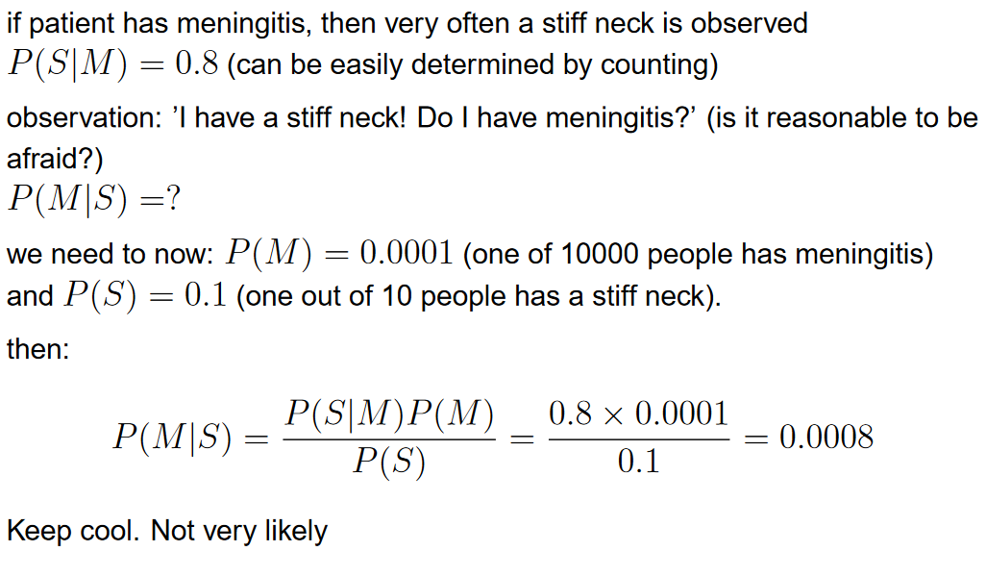
Bayes Rule Example
Bayes rule - Example

Slide 62

Thank you for your time!!

